Slide 1
Airline Safety Concerns
By: Felipe Rodriguez

Slide 2


Agenda
Data Overview
Injuries and Causes
Phase of Accidents and Defining Events
Impact
Profit and Revenue
Plan

Slide 3
Goal
High level overview of data
Impact of Media
Plan Proposal

Slide 4
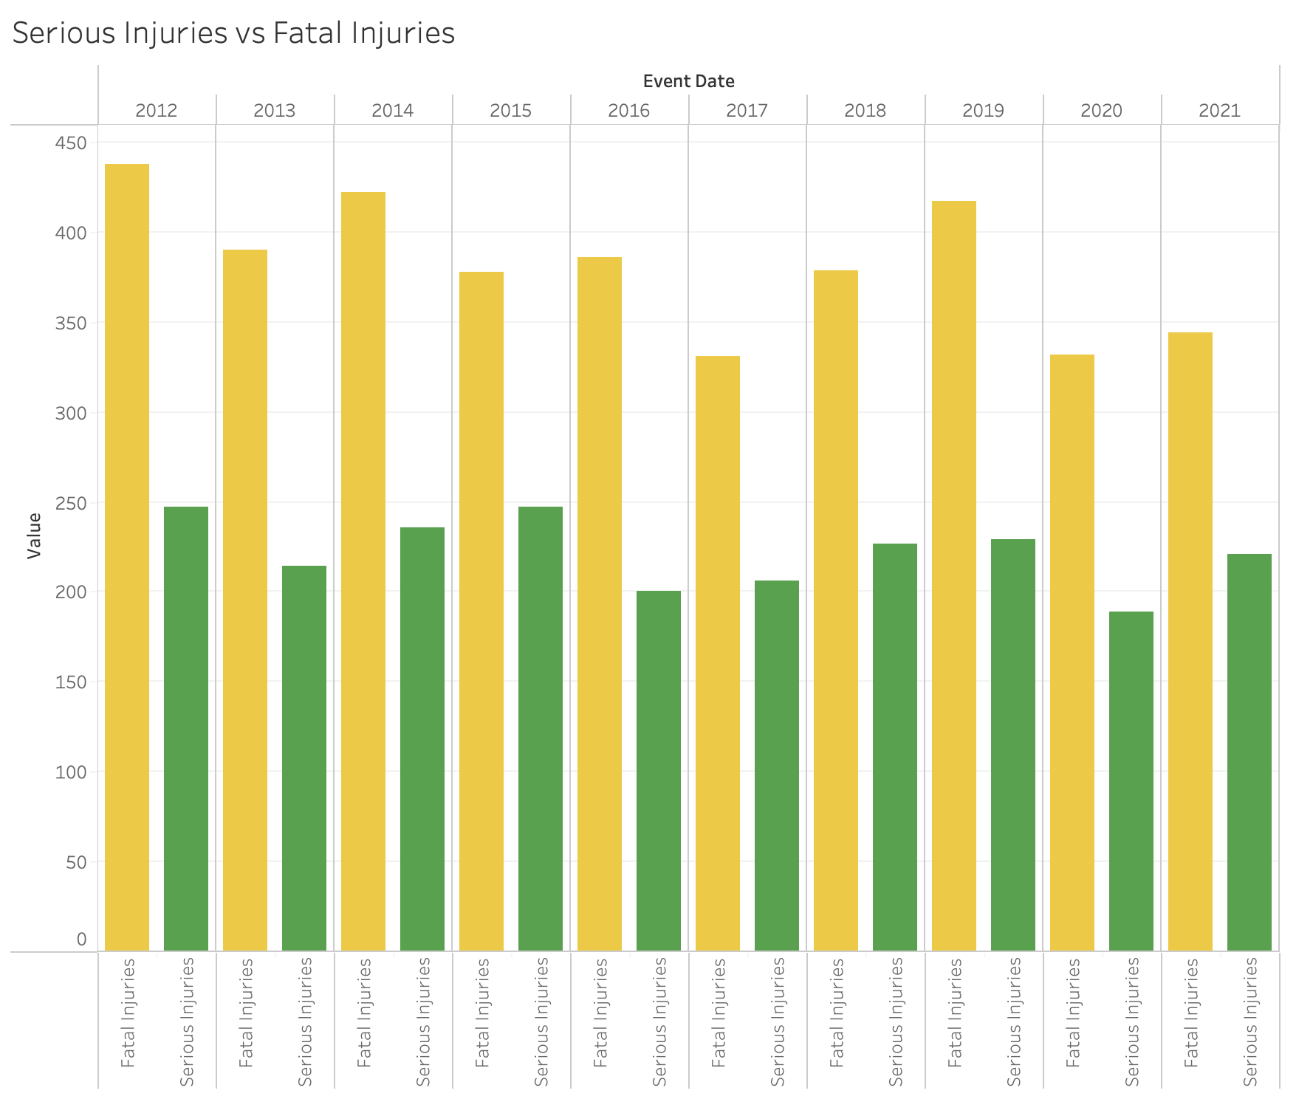
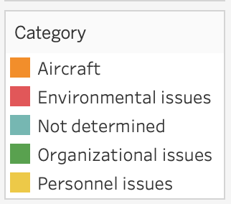
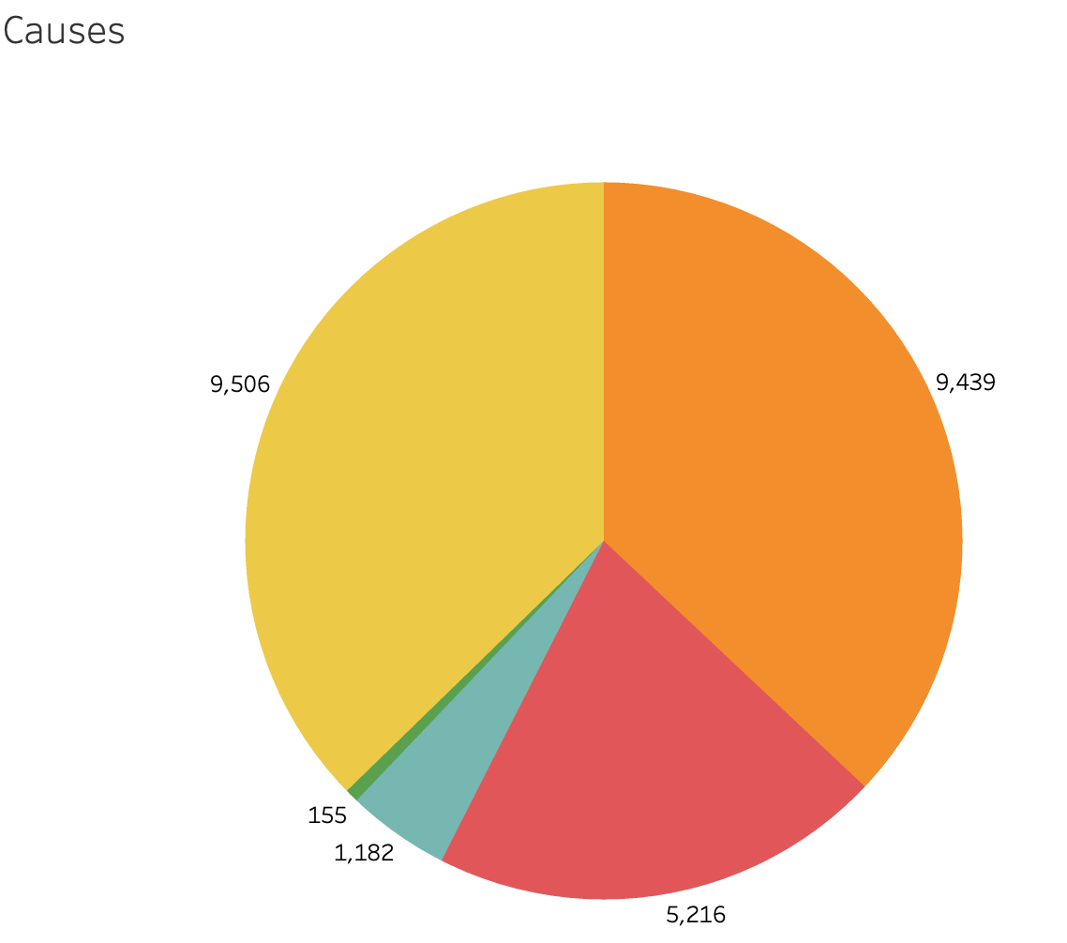
Injuries and Causes
Accidents slowly dropping
Lead causes are personnel issues and aircraft

Slide 5
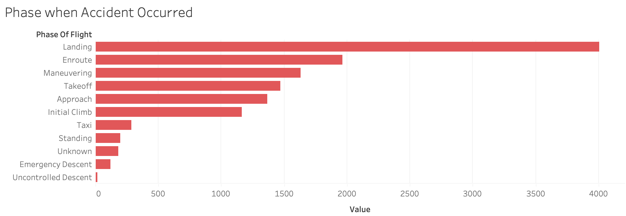
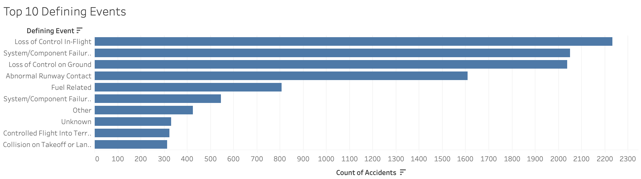
Phases of Accidents and Defining Events
Landing is where the accidents occur most frequently
Top the events are loss of control and component failures

Slide 6
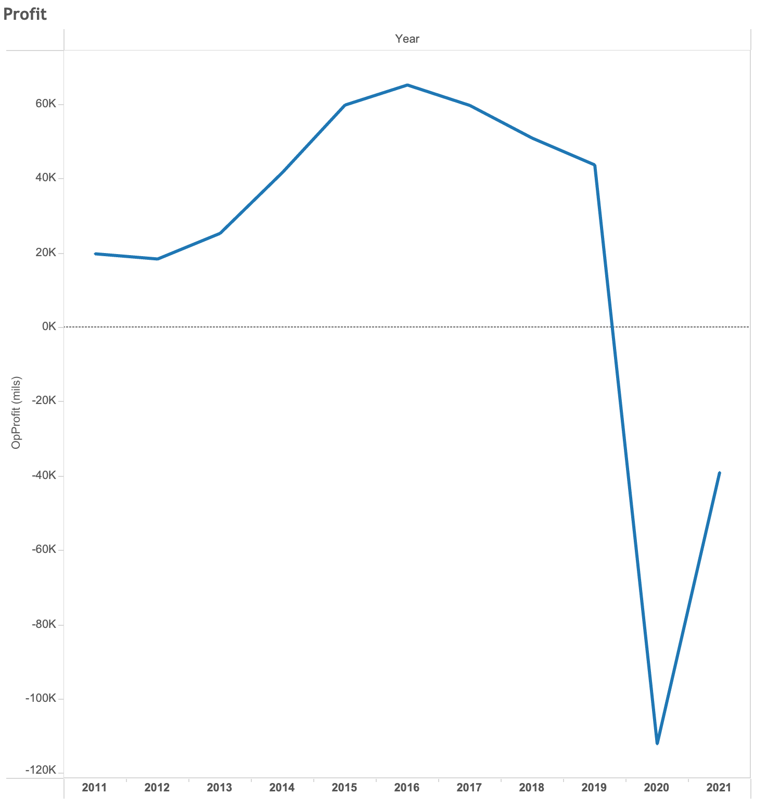
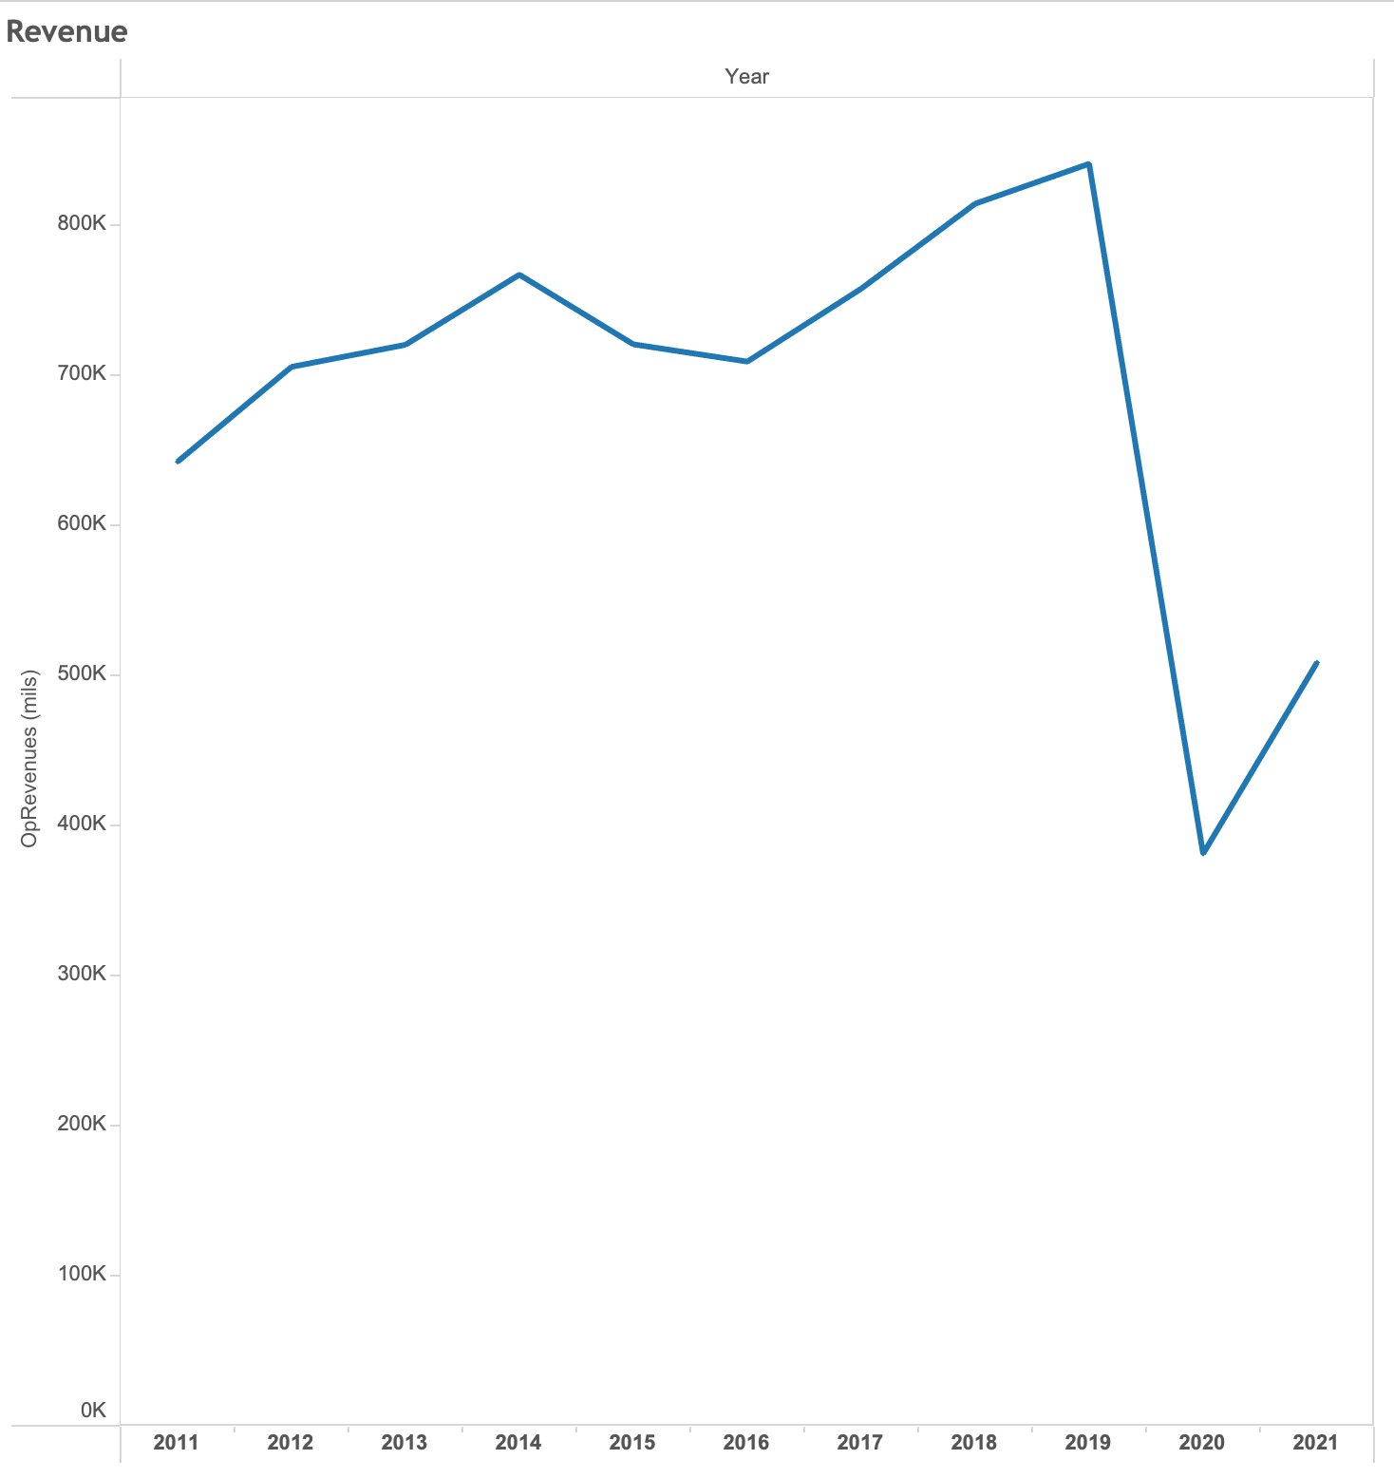
Impact - Profit and Revenue
Revenue and Profit dip over the last few years
Future Prediction is to increase

Slide 7

Plan Proposal
Transparency with Public
Ethically correct – Displays the facts
Data up to 2021 – Gather more recent Data to back up ethically
Discuss potential verification of events
Showcase trends we see
Accidents Lessening over time
Key issues – Aircraft and Personnel
Commit to Maintaining Aircraft to higher standard
Commit to Re-training Personnel

Slide 8
Reference
Airlines For America. (n.d.). Economic Impact of Commercial Aviation. Airlines For America. https://www.airlines.org/impact/
National Transportation Safety Board. (n.d.). General Aviation Accident Dashboard: 2012-2021. General aviation accident dashboard: 2012-2021. https://www.ntsb.gov/safety/data/Pages/GeneralAviationDashboard.aspx

